Slide 1
Patient Safety
Education and training to European Specialist in Laboratory Medicine

Slide 2
Why Patient safety
70% of medical decision based on laboratory medicine
Risk of wrong result or wrongly interpreted result leads to wrong treatment, possibly causing dead
Therefore: right specialist

Slide 3
Patient Safety
Harmonisation

Slide 4
What should be harmonised?
Laboratory investigation and analysis
Laboratory data transfer (e-lab communication)
Laboratory data interpretation
Therefore
Specialist Laboratory Medicine

Slide 5
Patient expectation
Laboratory investigation
Quality
  Right result
  Right time
  Rightly taken sample
  Right calibration or harmonisation

Slide 6
Patient expectation
Laboratory data transfer
Quality
  Right result
  Right time
  Right units
  Right calibration or harmonisation

Slide 7
Patient expectation
Laboratory data interpretation
Quality
  Right interpretation
  Right consult
  Right time (24/7)

Slide 8
Patient expectation
Harmonisation
Same result, same interpretation, same consult everywhere

Slide 9
Patient expectation safety
Harmonised
European specialist in laboratory medicine

Slide 10
The Development of
Common Training
Harmonisation

Slide 11
Why Common Training?
Cardiologist ≠ Cardiologist
Urologist ≠ Urologist
Clinical biochemist ≠ Clinical Biologist ≠ Clinical chemist ≠ Biological Chemist

Slide 12

Harmonization is needed

Slide 13

Harmonization is needed

Slide 14
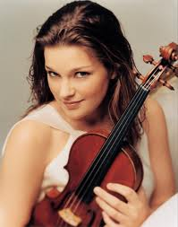

Harmony in music

Slide 15
Harmonization
The right road, the right fruit, the good music for
Specialists in Laboratory Medicine
Directive Recognition Professional Qualifications

Slide 16
Why Harmonisation?
Why Common Training?
For
Patient safety!

Slide 17

The EC4 European Register of
Specialists in Laboratory Medicine

Slide 18
European Register of Specialists in Laboratory Medicine
Directive on Recognition of Professional Qualifications 2005/35/EC (DG Market): common training
Quality standard for our profession

Slide 19
European Register of Specialists in Laboratory Medicine
Kept by Foundation EC4
Foundation Board
Board of Governors
  National representatives of EFLM related national societies
Registration Commission
  National representatives of NLMRC

Slide 20
European Register of Specialists in Laboratory Medicine
European Syllabus (to be revised)
Code of Conduct
Guide to the Register
Equivalence of Standards of National Register(s)

Slide 21
Applicants to the European Register of Specialists in Laboratory Medicine
Member of national Register of EU member state
National Register granted Equivalence of Standards
Fulfill criteria of Guide to the Register

Slide 22
Applicants to the European Register of Specialists in Laboratory Medicine
Medical education
Pharmaceutical (biologiste) education
Scientific education
Harmonised specialist training?

Slide 23
European Register of Specialists in Laboratory Medicine
Registration
Re-registration (CPD, re-registration in national register)
Automatic registration
Equivalence of Standards revised

Slide 24
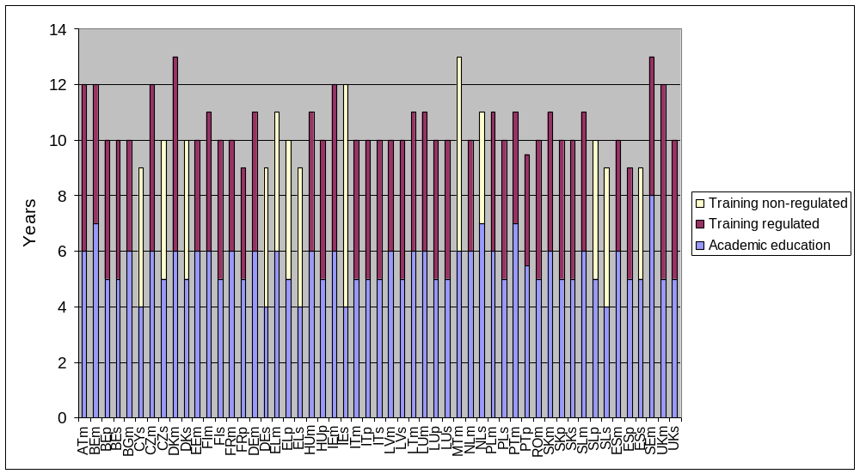
Level of training
Rob Jansen November 9th 2011

Slide 25

Level of training requirements
a total duration of education plus training of ten years
a minimum duration of academic education including a masters degree in medicine, pharmacy or science, of four years plus one year academic development
flexibility in the additional academic development year consisting of academic education, a PhD, year of scientific research resulting in published peer reviewed article
a minimum duration of training of four years plus one year additional experience
registration in the appropriate national register if it exists
flexibility in the additional experience year consisting of extra academic education, a PhD, work experience, extra training years, courses, traineeships

Slide 26
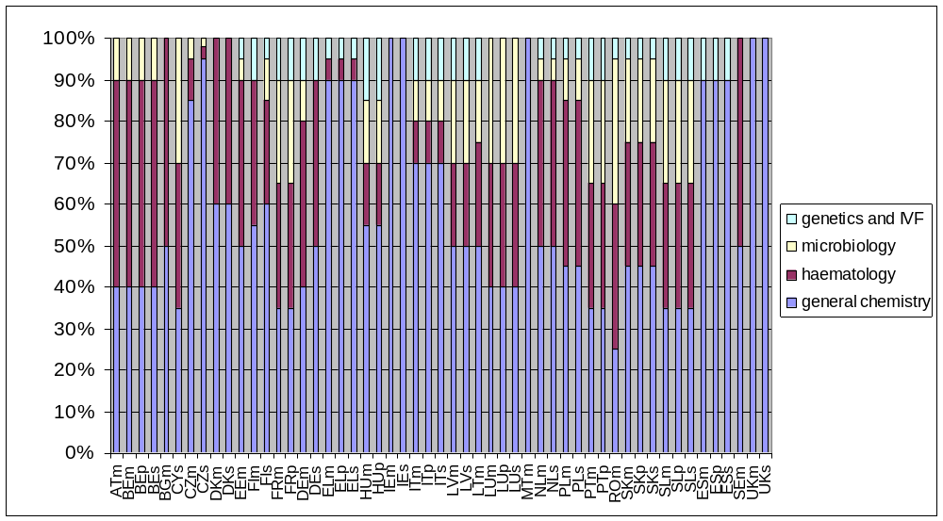
Training content
Rob Jansen November 9th 2011

Slide 27
European Register of Specialists in Laboratory Medicine
European Standard for professional qualifications
Co-operation with UEMS
Basis for Common Training system of EC Directive on Recognition of Professional Qualifications?
Name of Profession same in all countries
Harmonised requirements

Slide 28

Harmonisation in Europe

